Slide 1
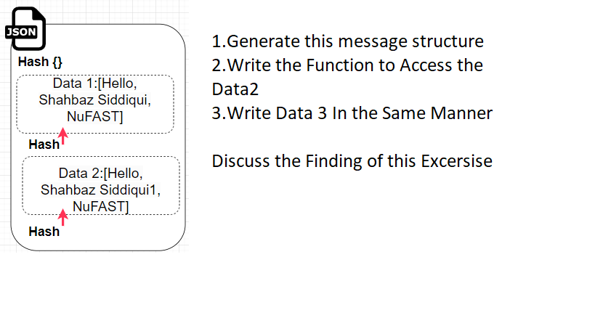
Task-1 With Client Server Program having 2 Client A and B and Server
Sending Message: A->Server A->Server->B B ->Server->A
Task-1 With Client Server Program
Group Task
Marks 0.5
Focus :Implementation of Data immutability also Verification of this Concept, No use of encryption of data is used

Slide 2
Task-2 Implement the concept of Goofy Coin
Sending Message: A->Server A->Server->B B ->Server->A
Group Task
Marks 0.5
Focus :Implementation of Goofy Coins
Rules Such as Create Coin Pay to script

Slide 3
Task-3 Implement the concept of double Spending Problem
Group Task
Marks 1
Focus :Implementation of Goofy Coins
Rules Such as Create Coin Pay to script

